Slide 1
Edgetcd
Max, Sathish, Kannan, Divyank, Mrunal, Animesh

Slide 2
Project Timeline
Blockchain focus with consensus algorithms
Proof-of-Work, Proof-of-Authority, Proof-of-Stake, Paxos, Raft (BoltDB)
Focus on key-value stores within Minikube cluster
Expand to eventual consistency to provide high availability and load balancing
Etcd conflict-free replicated data type research and emulation ideations
Vehicle swarm real-world application within Kubernetes environment
Emulating cell tower processing with MQTT broker
Publisher/subscribers acting as vehicles

Slide 3
Problem Statement
Autonomous vehicles are facing a problem today which involves real-time communication on the road. Although vehicle-to-vehicle communication with 5.9-GHz frequency is becoming capable over various distances, an adaptive hybrid network concept is also important reflecting European standard IEEE 802.11ad which focuses on providing a framework for vehicle communication with radar technologies at 60-GHz frequency (shorter distances, faster speed). This includes utilizing wireless technologies like 5G and LTE mobile communications for distributed systems to transmit important data promptly while leaving non-essential data to sync eventually across a swarm of vehicles in a specific radius. Criteria for selecting wireless communication includes distance availability and signal quality.
References: https://future-markets-magazine.com/en/markets-technology-en/communication-in-autonomous-vehicles/#:~:text=Communication%20in%20autonomous%20vehicles%20will,their%20surrounding%20area%20via%20WLAN.

Slide 4
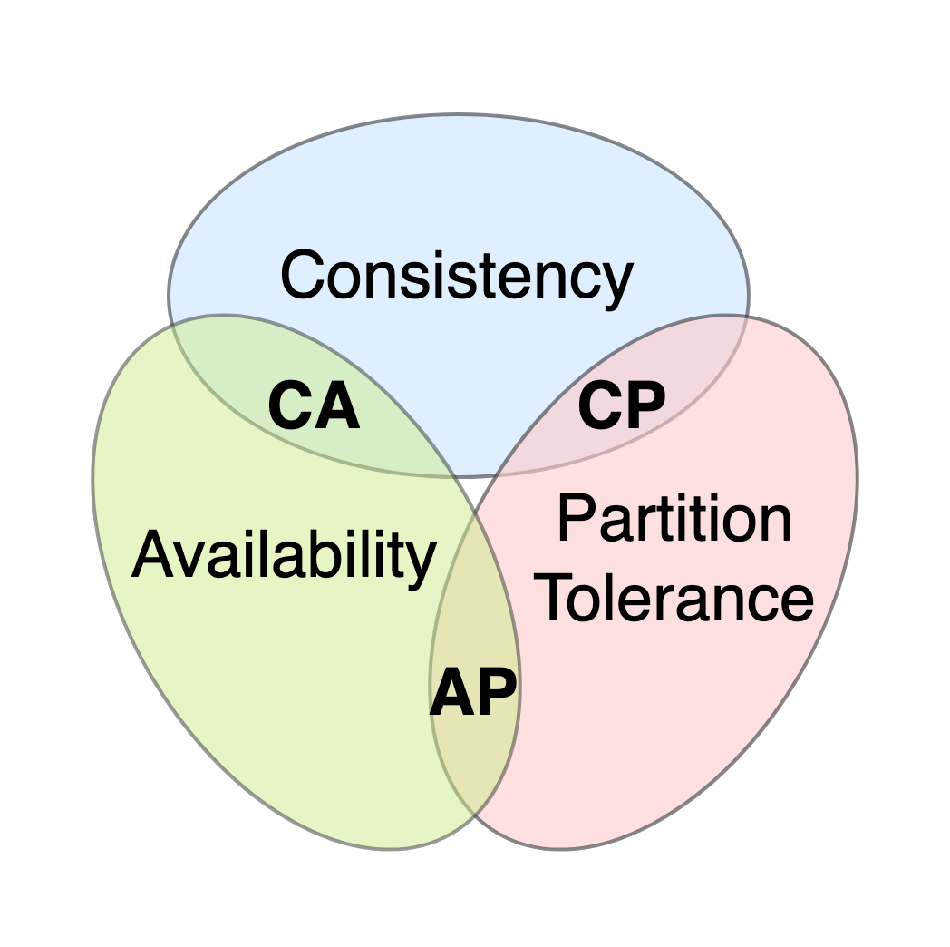
Cap Theorem (Brewer Theorem)

Slide 5
Project Plan
Equip autonomous vehicles with eventual consistency capable of transmitting updates to a cell phone tower for distributing data
Car Swarm example
Cars traveling in same direction forms swarm when driving at same speed
Eventual Consistency
Absolute speed and distance varies by second and is not important for full consistency
Update between cars every minute or so
Full Consistency
Number of vehicles active within swarm
Important vehicle updates (breaking from car)
Proximity sensor alerts
Cluster ID number
Individual vehicle ID numbers within swarm
Load utilization connected to edge cloud
Each services CPU usage
Needs to communicate to edge (every 10 seconds or so)

Slide 6
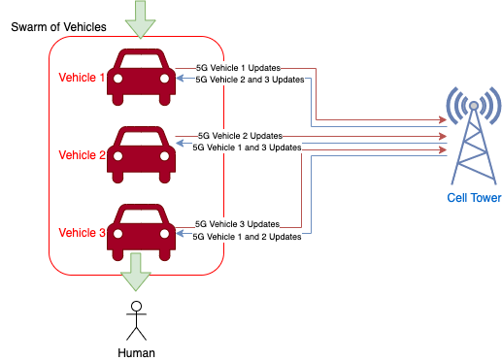
Real World Project Architecture

Slide 7
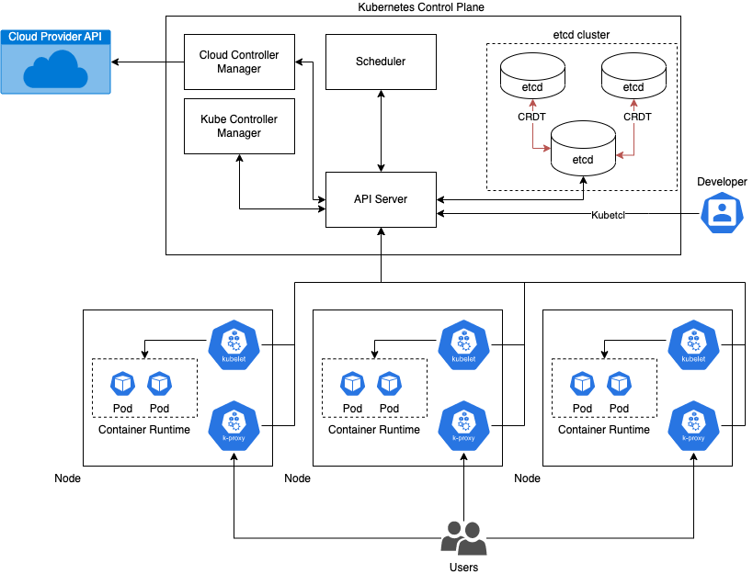
Kubernetes Environment

Slide 8
Project Plan Emulation
Minikube cluster containing single ‘Hivemq’ image metadata JSON output:
Cluster IP address - important for edge cloud to stay consistent with total Kubernetes objects
Contains ‘Hivemq Deployment 1’ - mimics swarm of vehicles
Holds ReplicaSet 1 with a single pod - mimics single vehicle
Metadata to represent ReplicaSet
Pod 1 has ‘Hivemq’ - MQTT Broker - mimics cell tower
Metadata to represent Pod
Contains Control Plane
Metadata to represent Kubernetes control plane
Holds ‘API Server Service 2’
Contains ‘Hivemq Service 1’
Interconnects ‘Hivemq Deployment 1’ to ‘API Server Service 2’
Connects to ‘etcd’ key-value store
MQTT Client Publisher - Inputs ‘etcd’ JSON dump
Partition JSON format through MQTT broker:
Edge cloud lives in cell phone towers (publisher, subscriber with individual cars important metadata)
Edge cloud filters unnecessary car data and publishes important metadata back to car
MQTT Client Subscriber - Subscribes to topics from MQTT Broker
Client radios (publishing personal car data, Subscribers within cars to know other cars data updates)

Slide 9
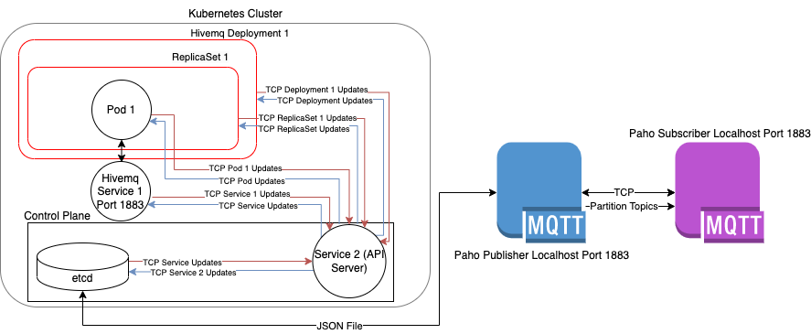
Previous MQTT Project Architecture

Slide 10
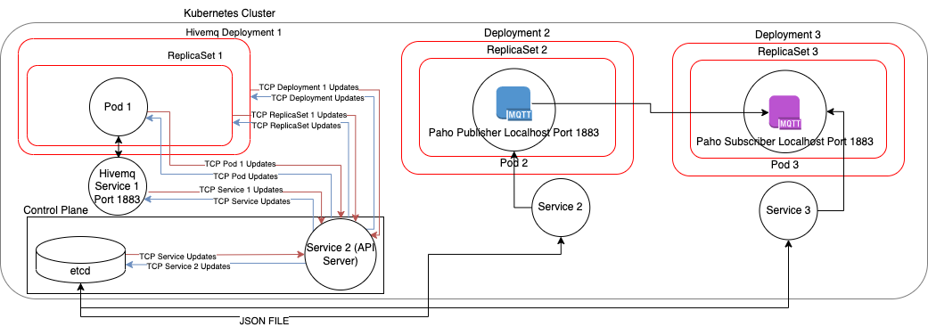
New MQTT Architecture

Slide 11
Emulated Project Overview
Start Minikube cluster VM
Apply Docker image Hivemq/Hivemq-CE to Minikube cluster
Deployment.yaml - Deployment of HiveMQ broker
Service.yaml - Configuration file for HiveMQ deployment pod to become service
WebSocket API
Expose HiveMQ service as external service target port
Internal port 30005 tunnelled to external port 1883
Permits Localhost accessibility (port 1883)
Utilize Paho MQTT client to publish/subscribe downloaded cluster JSON output
Publisher acts as cell tower/vehicle
Subscriber acts as vehicle/cell tower

Slide 12
Project Demo
Minikube for accessing Kubernetes Etcd storage of distributed data across edge nodes
Docker container with Hivemq MQTT Broker image to expose port 1883 within cluster
Paho Client Publisher to partition JSON edge node data and distribute to MQTT Broker server eventually (edge cloud)
Paho Client Subscriber views key value-pairs in topics eventually from MQTT Broker

Slide 13
Future Objectives
Tune partitioning for etcd important metadata
Inconsistent parsing and partitioning for unimportant metadata
Multiprocessing important & unimportant metadata across threads
Allows parallelism synchronizing unimportant metadata with longer delays
Kafka used as partitioning tool to store metadata in structured database (edge cloud)
Permitting broker/server itself (cell phone tower) to publish/subscribe to swarm of vehicles
Instead of acting as the host for a publisher/subscriber
Partitions the data for the vehicles
Containerizing application with vehicle metadata in Cluster

Slide 14
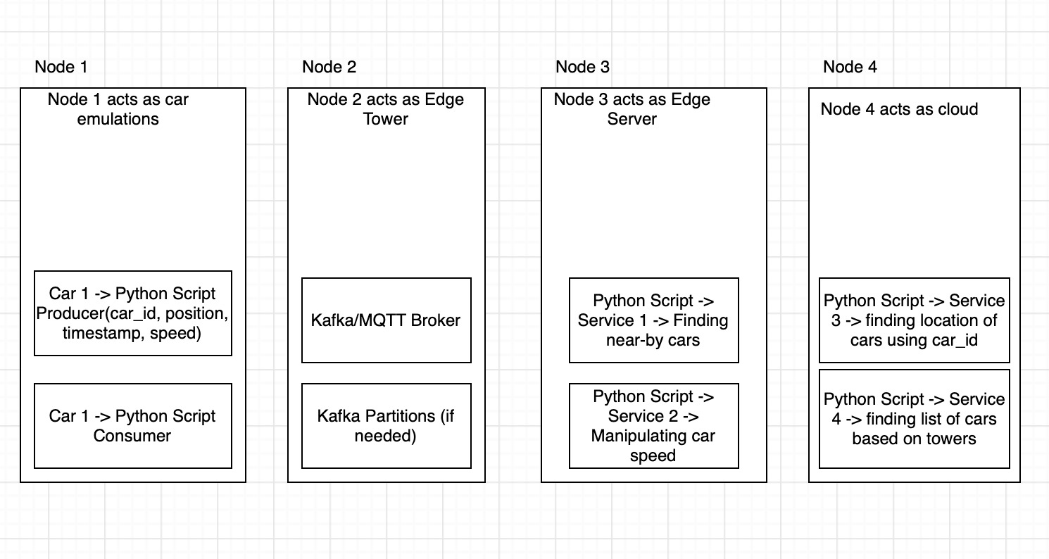
Future Design

Slide 15
Q&A

